Slide 1
Hajj Agency Management System
Developed By
Md. Sofiqul Islam
CCSL, J2EE -R_37
Under Supervision of
Mohammad Rajaul Islam
Instructor & Java Developer
J2EE, CCSL, Dhanmondi, Dhaka.

Slide 2
Software Requirement Specification (SPC)
Requirements:
The application will have following features:
There will be four types of user like super-admin, staff, group-leader and user.
There will be login for all application user.
Pilgrim(normal user) can register through email.
Super-admin control the whole application.
Super-admin can create user Role and admin.
Admin can see, add & edit every step of the application and staff can see, add & edit pilgrim.
Group leaders can only see own pilgrims status & can edit their profile.
Pilgrim or User can edit their profile from user-list if he registered.

Slide 3
Software Requirement Specification (SPC) Continue……
Analysis & Design:
Brainstorming Diagram
Use Case Diagram
Class Diagram

Slide 4
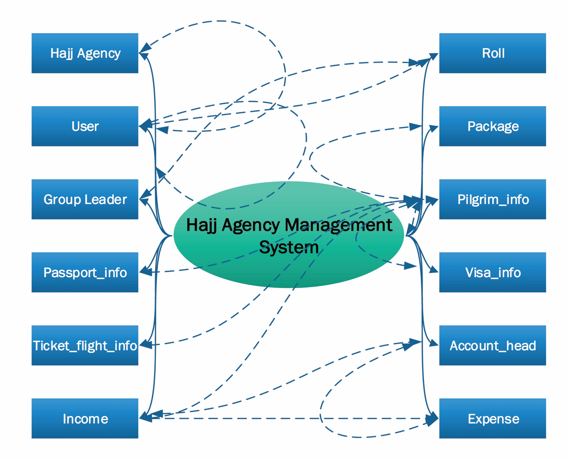
Brainstorming Diagram

Slide 5
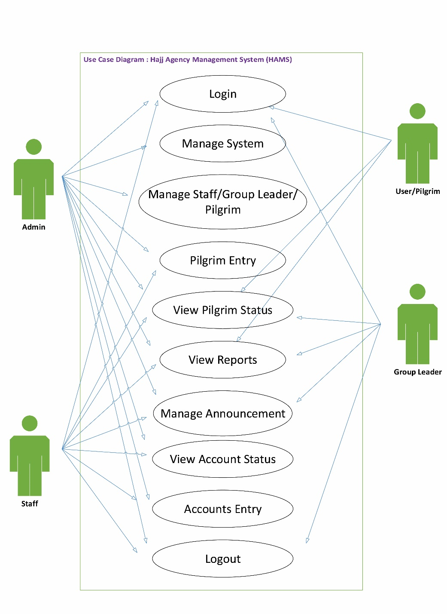
Use Case Diagram

Slide 6
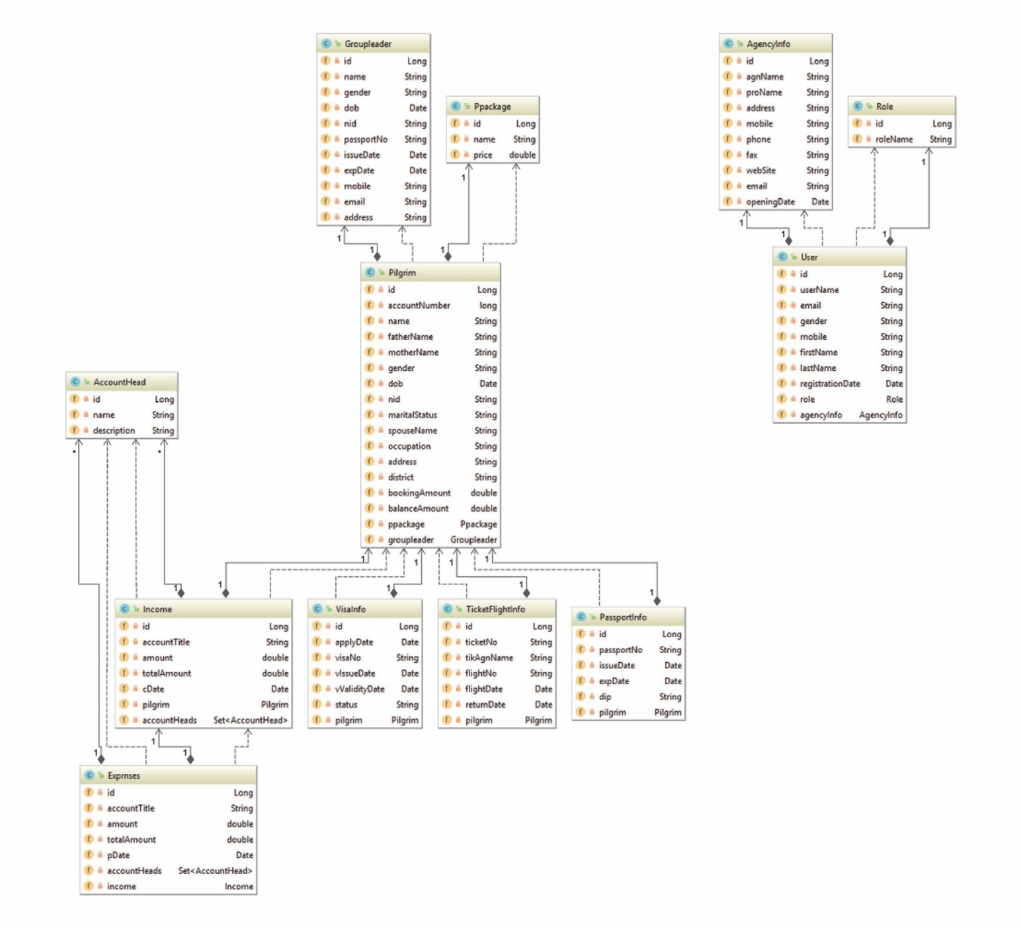
Class Diagram

Slide 7
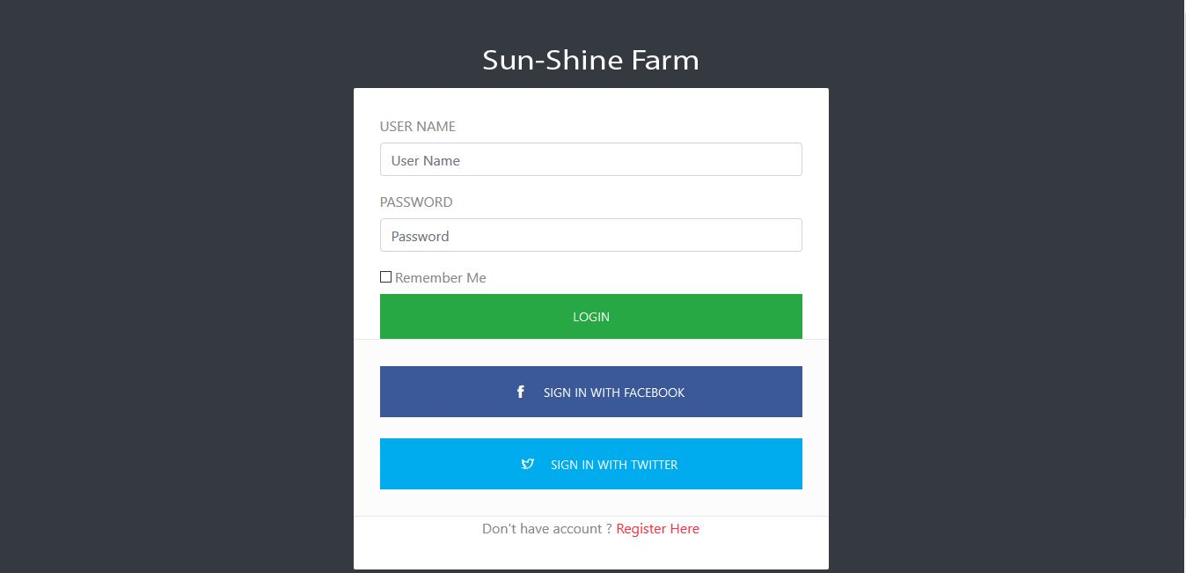
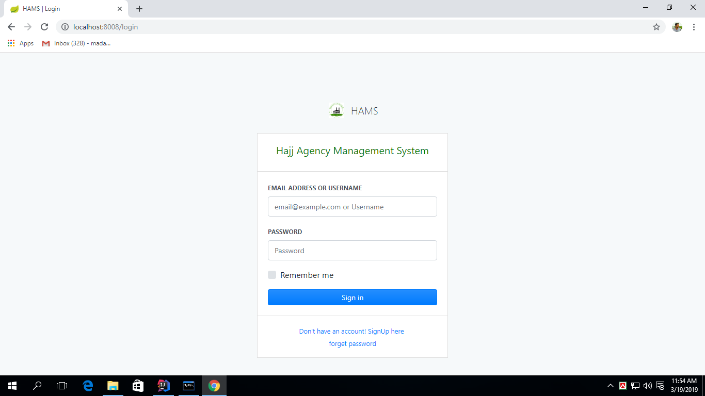

Slide 8
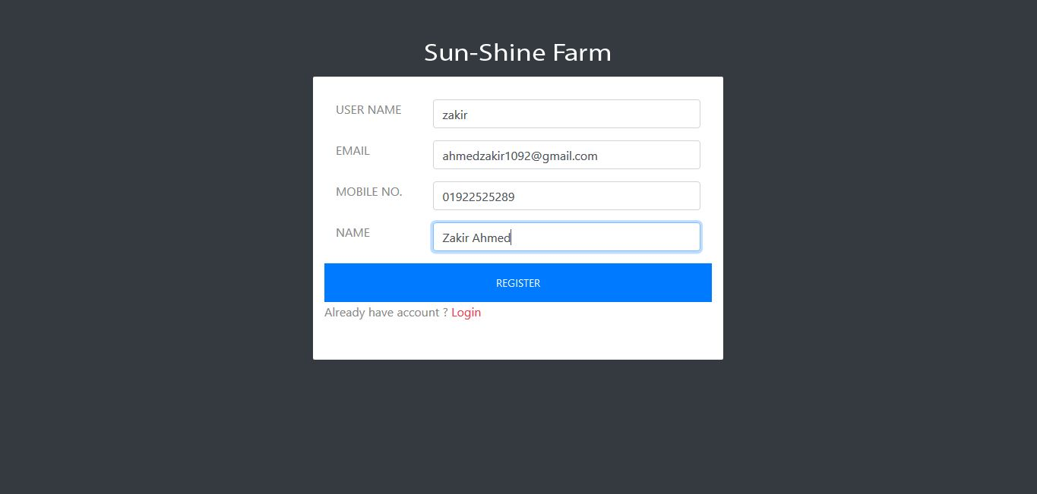
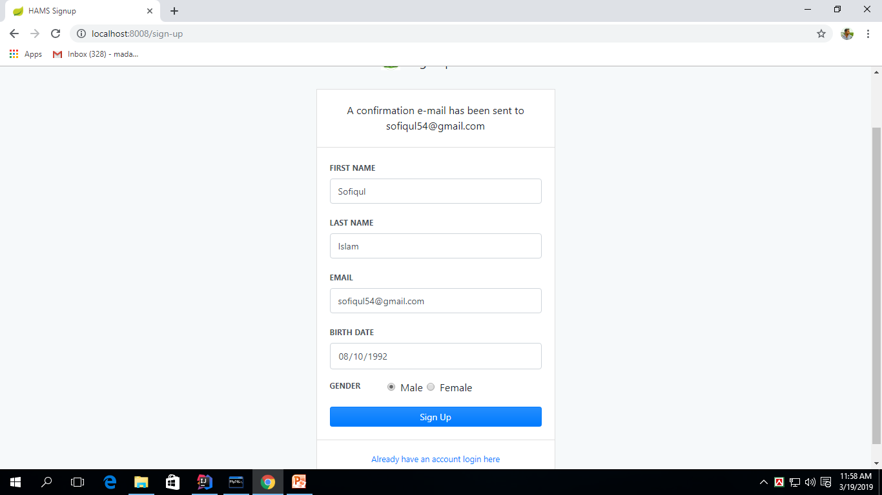

Slide 9
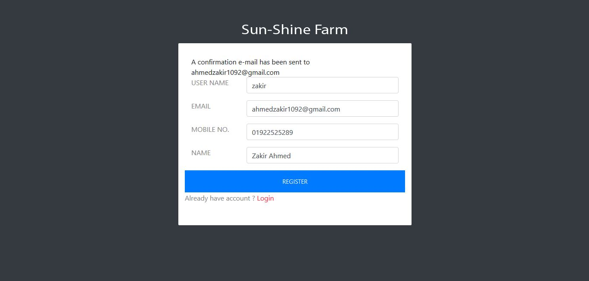
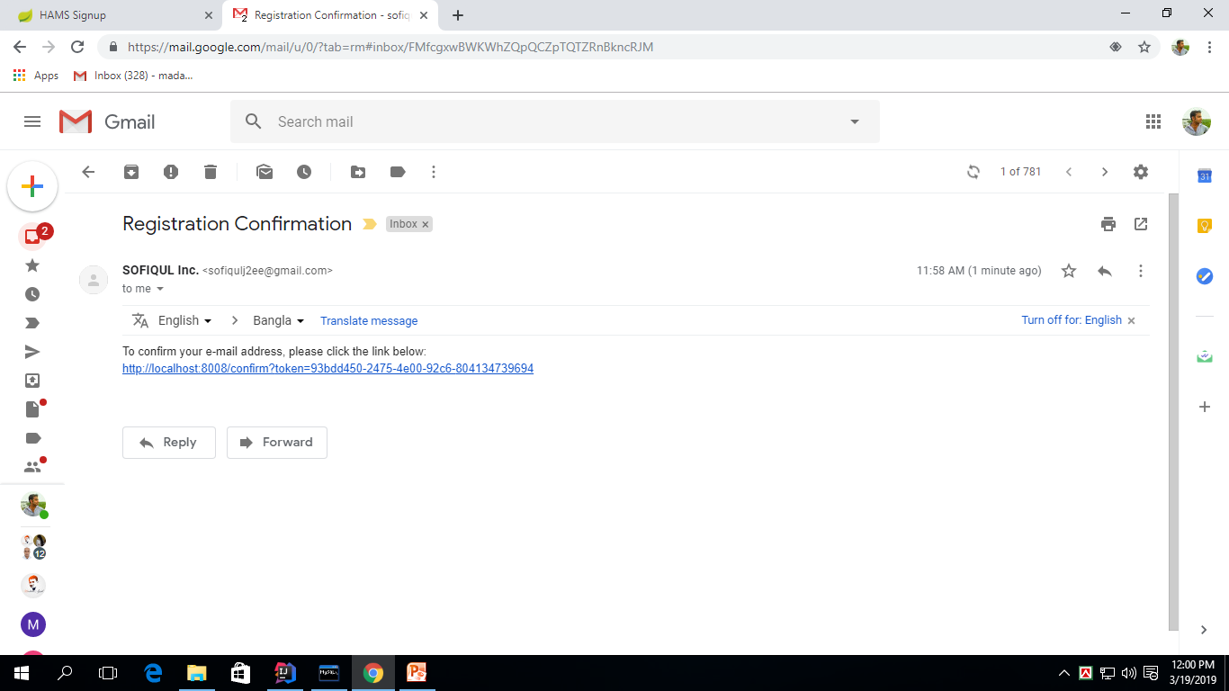

Slide 10
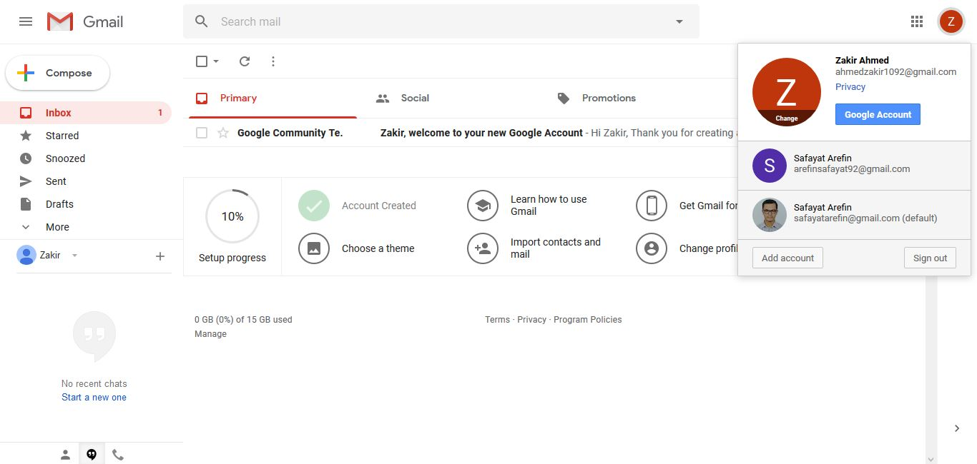
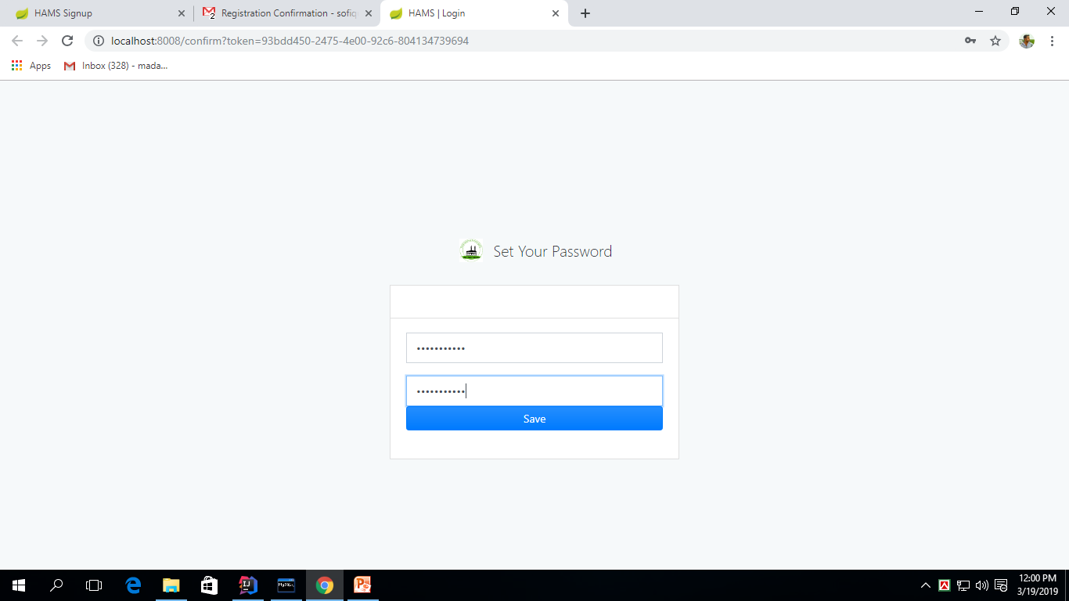

Slide 11
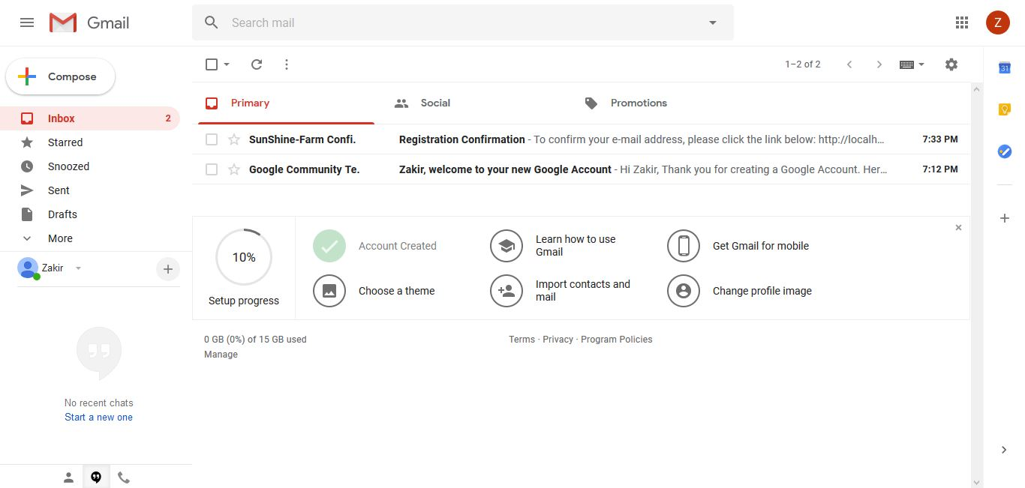
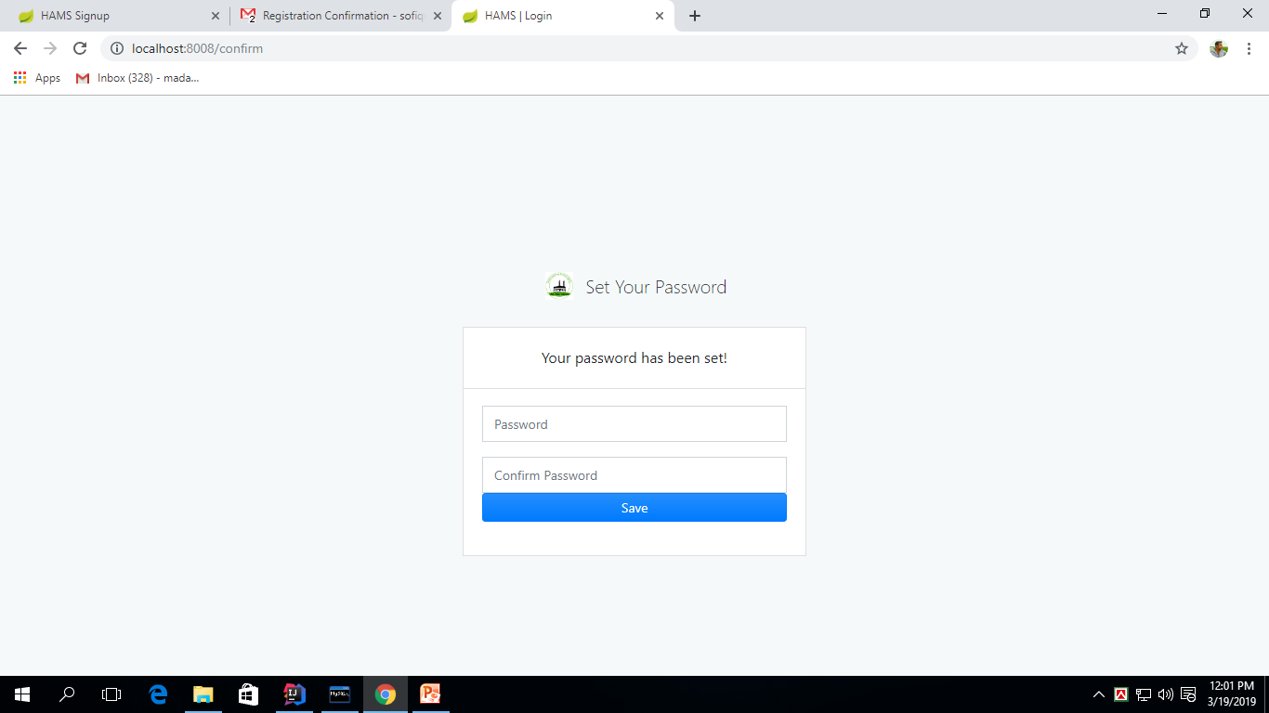

Slide 12
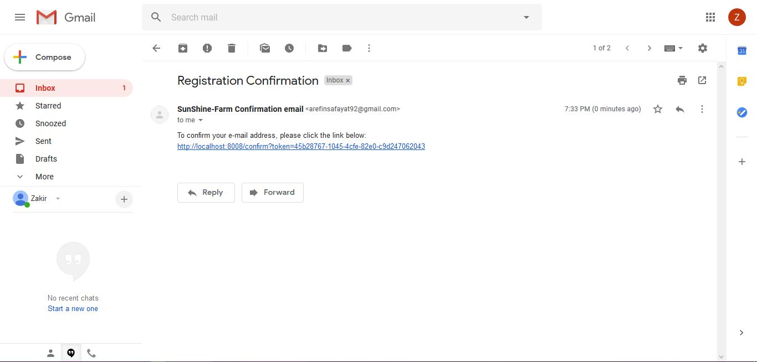
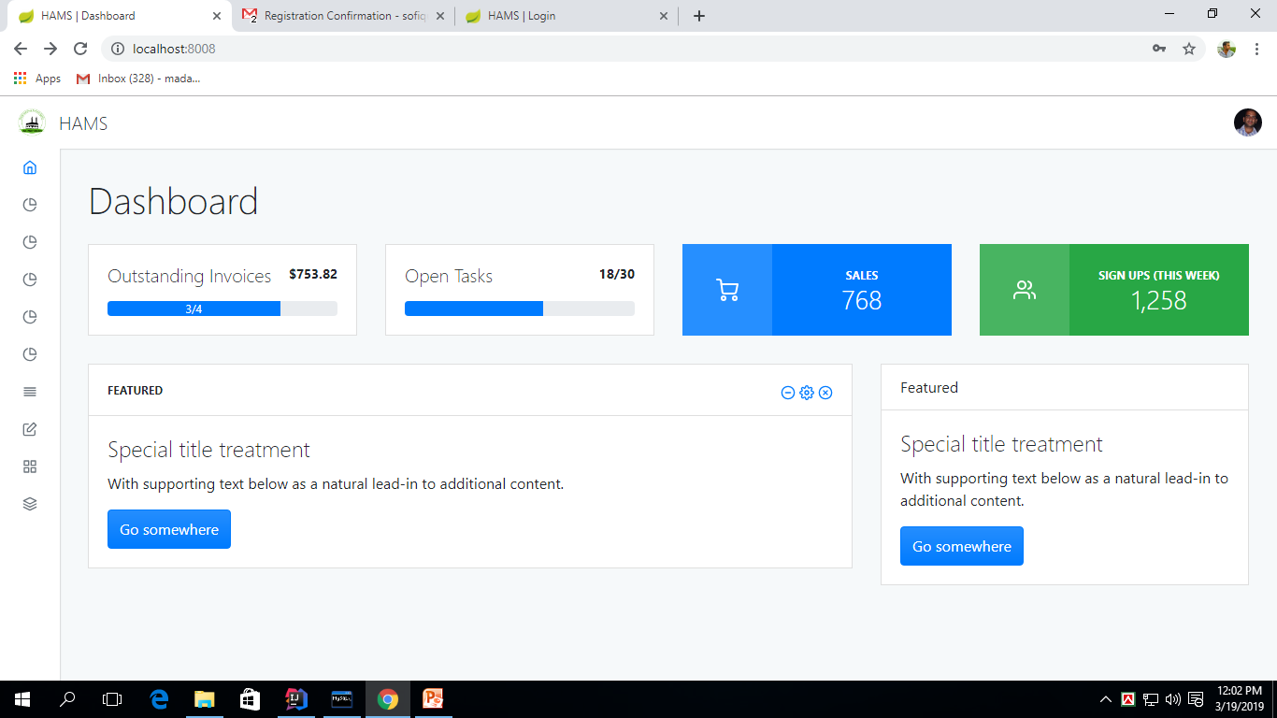

Slide 13
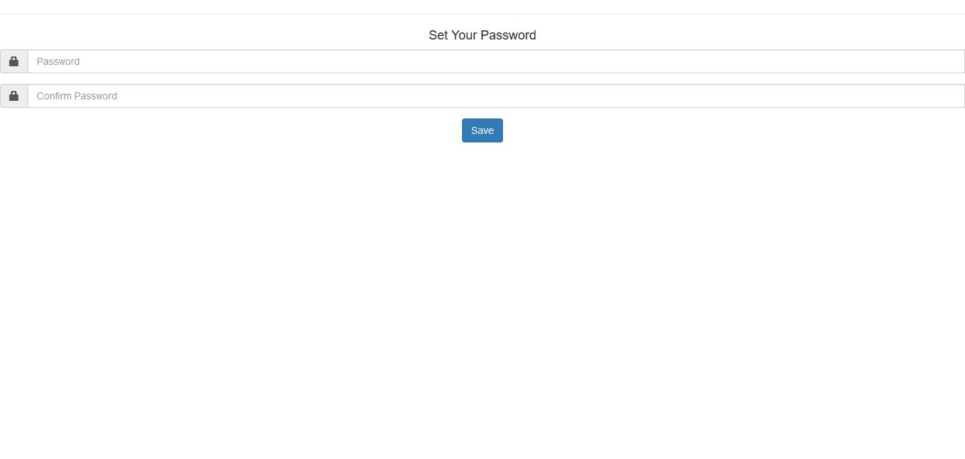
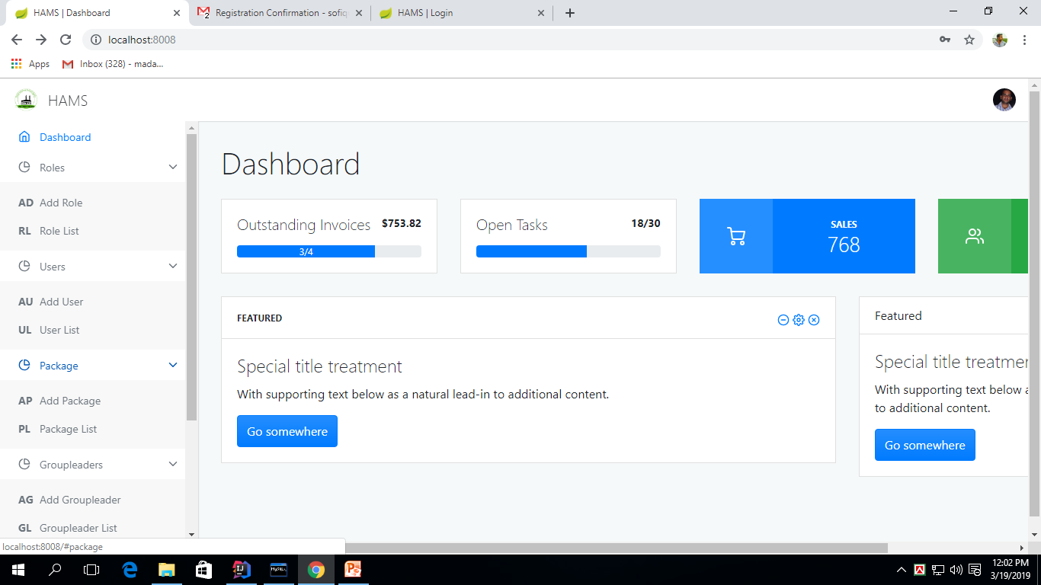

Slide 14
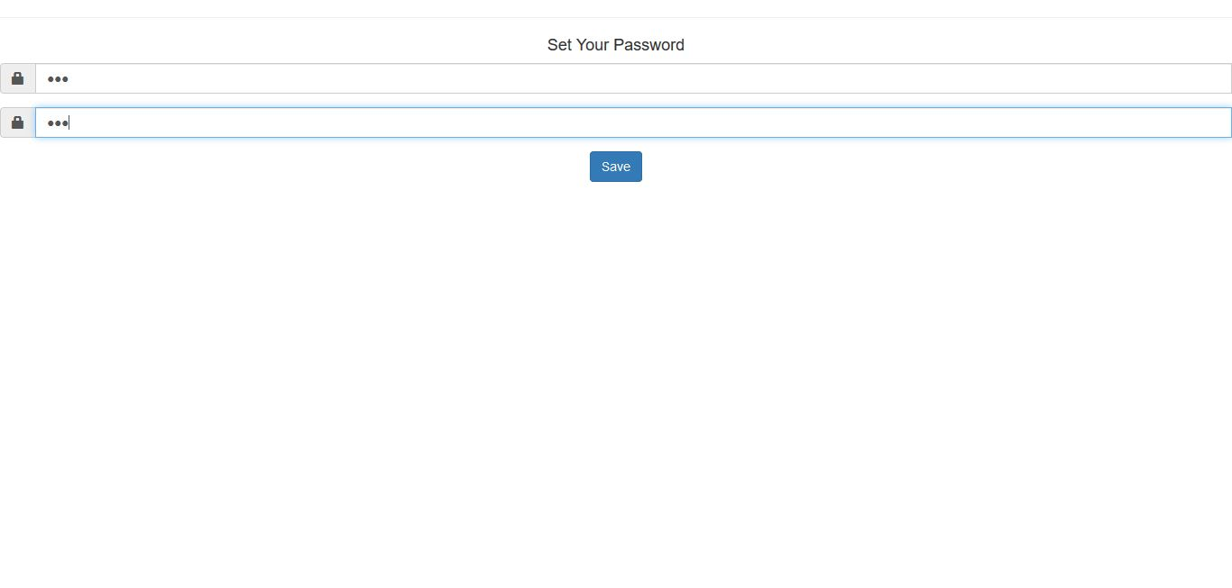
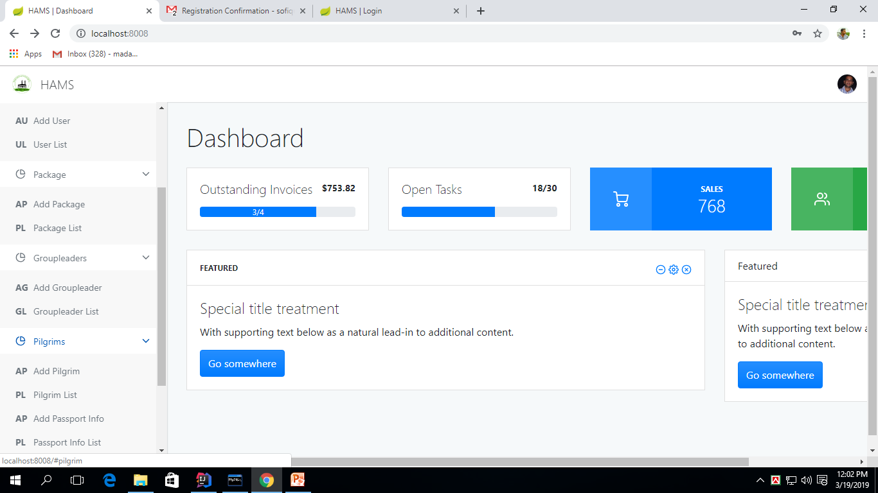

Slide 15
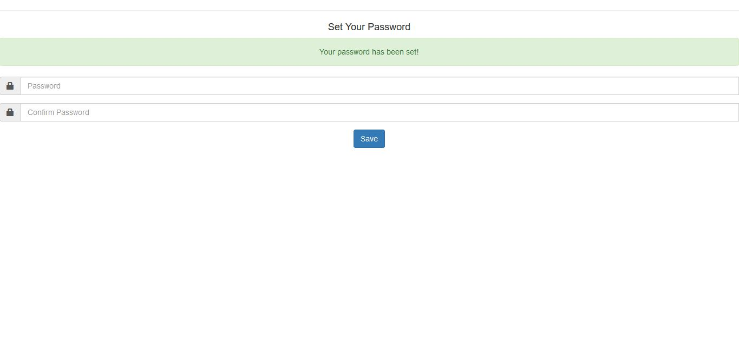
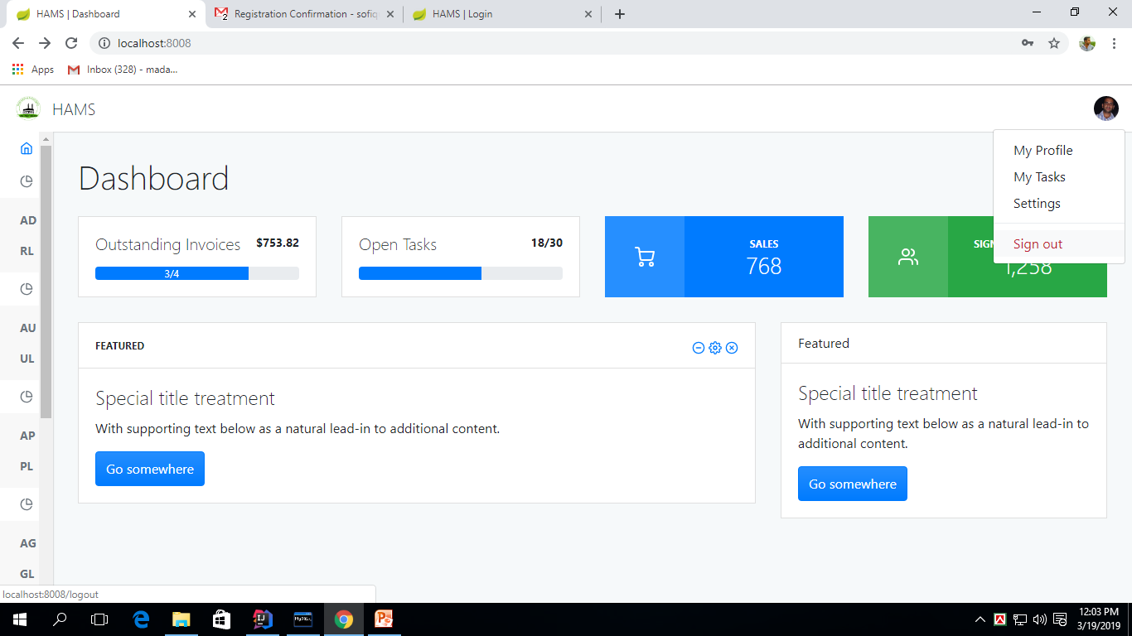

Slide 16
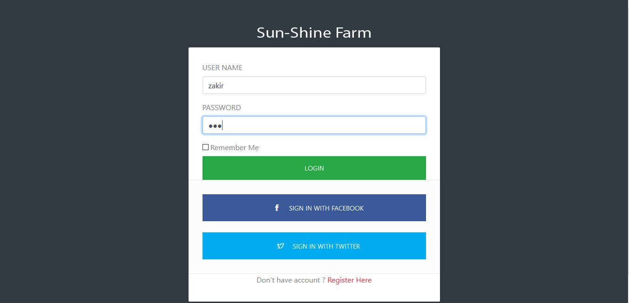
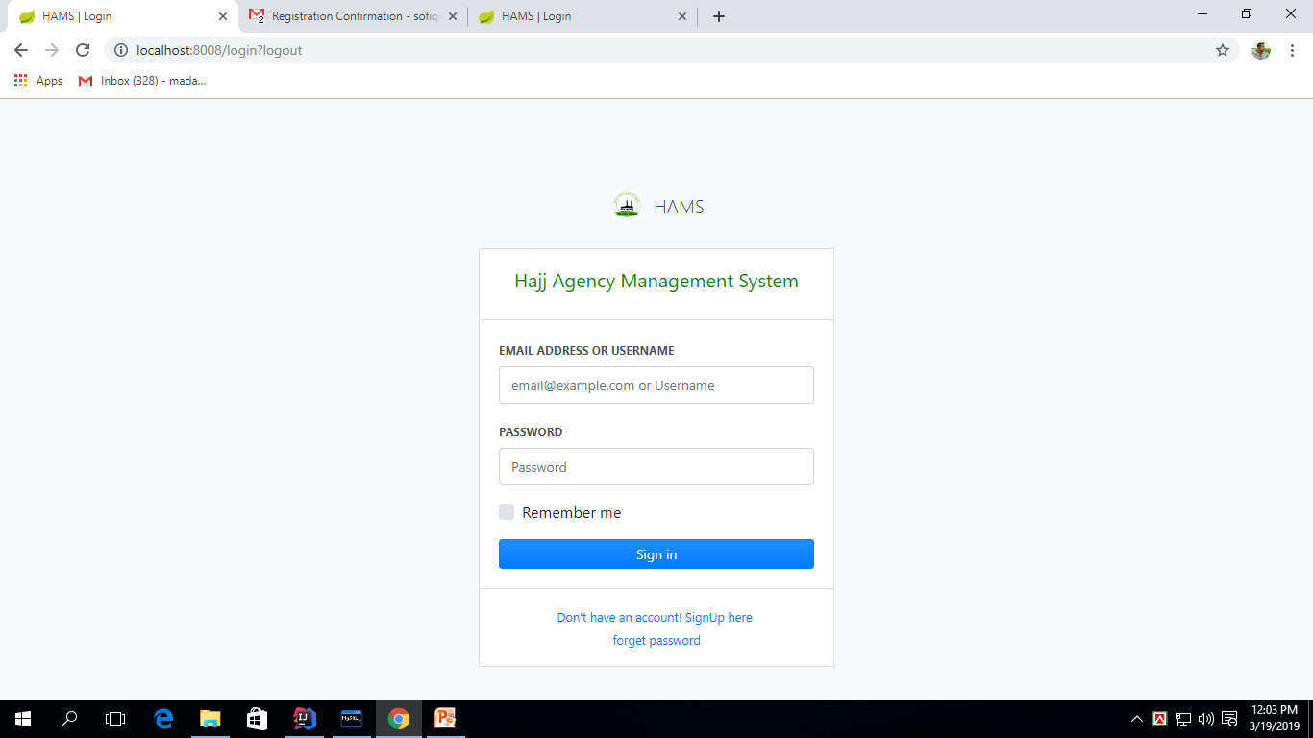

Slide 17
Thank You !

